Slide 1

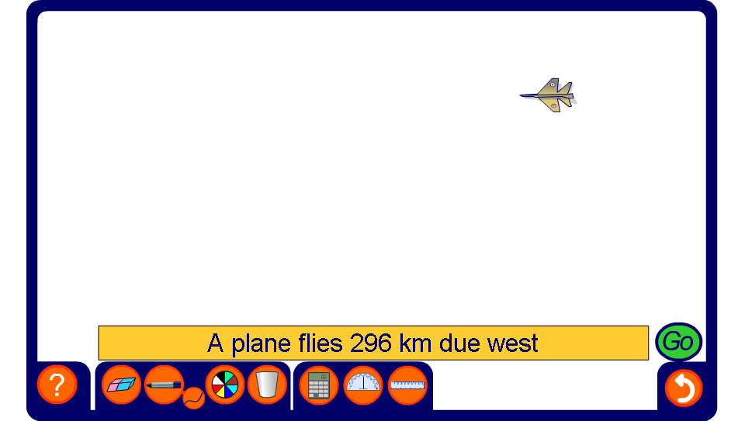


Flight path problem
Notes:
Use Pythagoras’ Theorem to calculate the distance of the aeroplane from the starting point.

